Slide 1
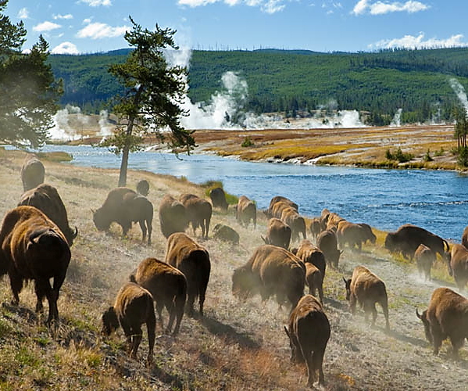
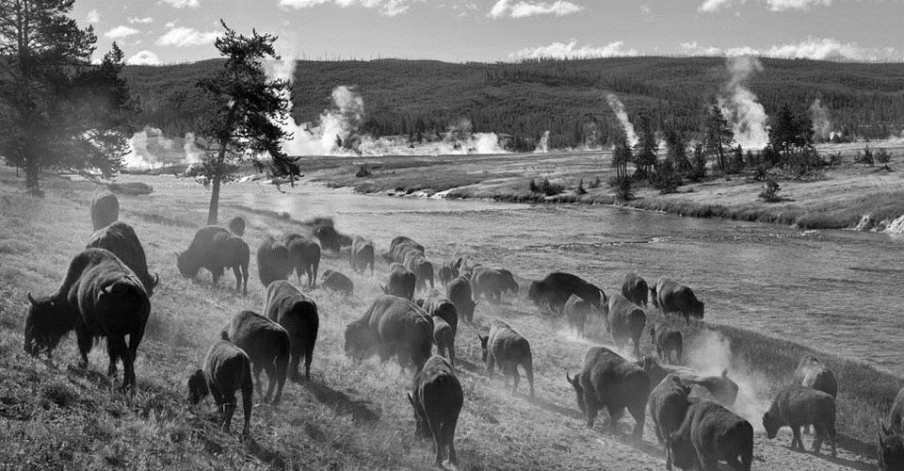

Biodiversity for the National Parks
Capstone

Slide 2
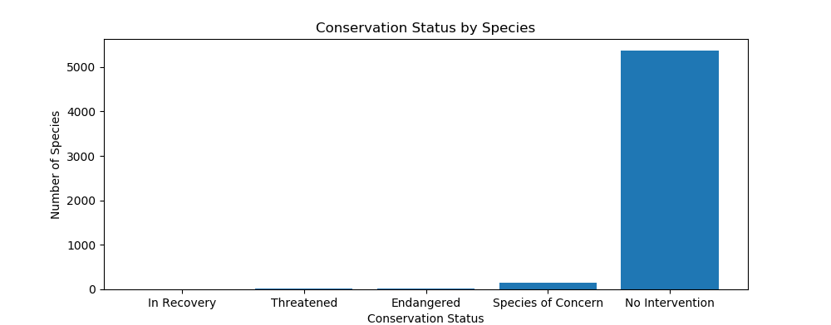
Conservation Status
Number of Species: 5541
Category: Mammal, Bird, Reptile, Amphibian, Fish, Vascular Plant, Nonvascular Plant
Conservation Statuses:

Slide 3
Percent of Protected
Category | Number of Not Protected | Number of Protected | Percent of Protected
Mammal | 146 | 30 | 17.05%
Bird | 413 | 75 | 15.37%
Reptile | 73 | 5 | 6.41%
Amphibian | 72 | 7 | 8.86%
Fish | 115 | 11 | 8.73%
Vascular Plant | 4216 | 46 | 1.08%
Nonvascular Plant | 328 | 5 | 1.50%

Slide 4
Chi-Squared Test for Significance
P-value of the difference between the percentages of protected Birds and Mammals: 68.76%
P-value 0f the difference between the percentages of protected Reptiles and Mammals: 3.84%
Conclusion:
Birds and Mammals are more likely to be endangered than others. Conservationists should concerned more about them.

Slide 5
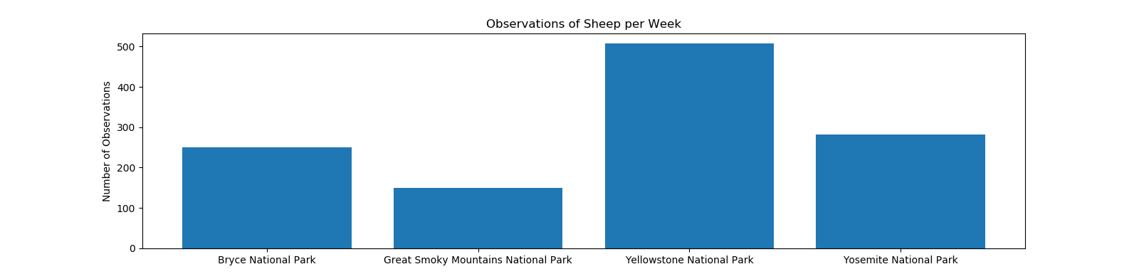
Observations of Sheep
Park | Observations
Bryce National Park | 250
Great Smoky Mountains National Park | 149
Yellowstone National Park | 507
Yosemite National Park | 282

Slide 6
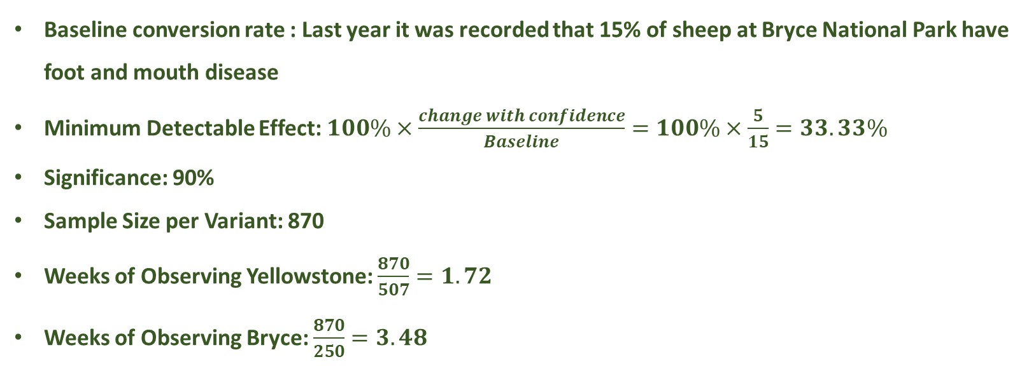
Sample Size for the Foot and Mouth Disease Study
Baseline conversion rate : Last year it was recorded that 15% of sheep at Bryce National Park have foot and mouth disease
Minimum Detectable Effect: $100\%×\frac{change with confidence}{Baseline}=100\%×\frac{5}{15}=33.33\%$
Significance: 90%
Sample Size per Variant: 870
Weeks of Observing Yellowstone: $\frac{870}{507}=1.72$
Weeks of Observing Bryce: $\frac{870}{250}=3.48$

Slide 7
Thank you!

